Slide 1
A Syntactic Analysis of Motion Predicates Expressed Through Serial Verb Constructions
in Southern Tati (Takestani Dialect)
Neda Taherkhani

Slide 2
Acknowledgements
1
Committee
Elena Benedicto, Mary Niepokuj, John Sundquist, & Arsalan Kahnemuyipour
IELLAB
Director: Elena Benedicto
Colleagues: Kwaku, Pin Hsi, Rene, Brittlea, Mathew, Xuan
Participants
Mahsa Taherkhani, Hamed Rahmani, & Seyyed Hamid Hosseini

Slide 3
1 | 2 | 3 | 4 | 5 | 6 | 7
Introduction
2
1.1. About the language
1.2. Goals
1.3. Approach
1.4. Proposal
1.4.1. Background on the descriptive properties of SVCs
1.4.2. Background on the syntactic structure of SVCs
1.4.3. Hypotheses

Slide 4
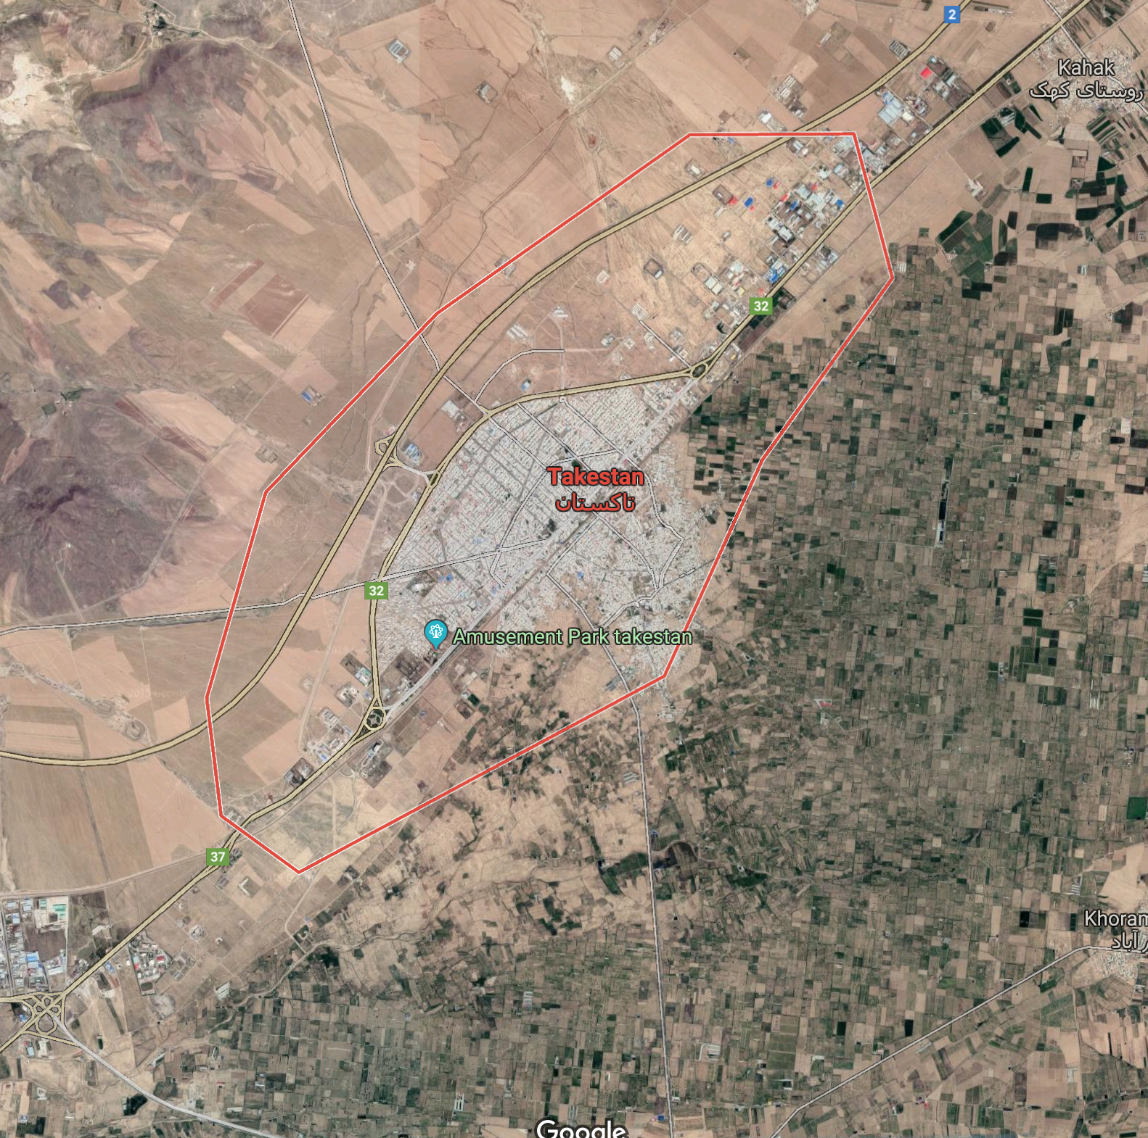
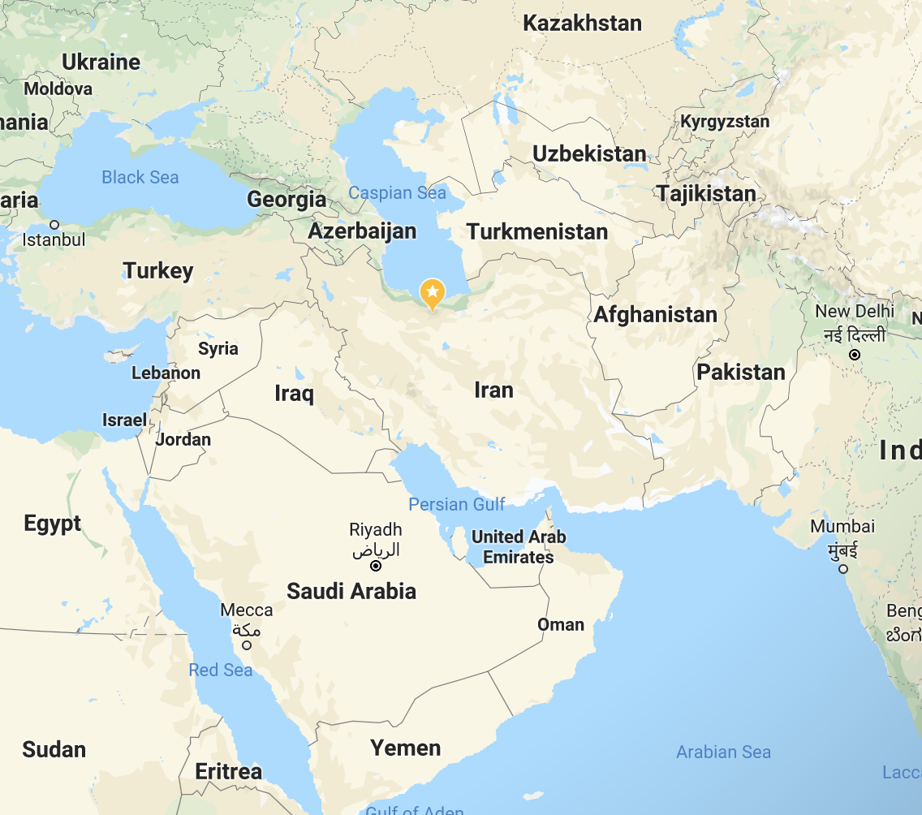
1 | 2 | 3 | 4 | 5 | 6 | 7
Introduction
3
1.1. About the language
Takestan, Qazvin, Iran
Southern Tati: Indo-European, Iranian, SOV

Slide 5
1 | 2 | 3 | 4 | 5 | 6 | 7
Introduction
4
1.2. Goals
Providing a syntactic representation of MPs in Tati
Sub-eventive decomposition of SVCs
Understanding MPs in Language
Contributing to the documentation of Tati
1.3. Approach
Generative-constructivist
Borer (2005), Ramchand (2008), Benedicto & Salomon (2014)

Slide 6
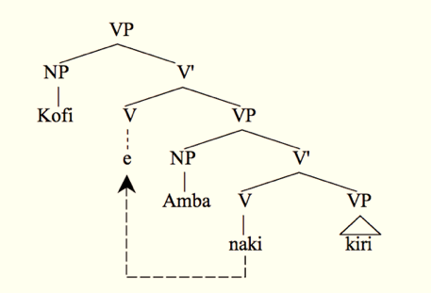
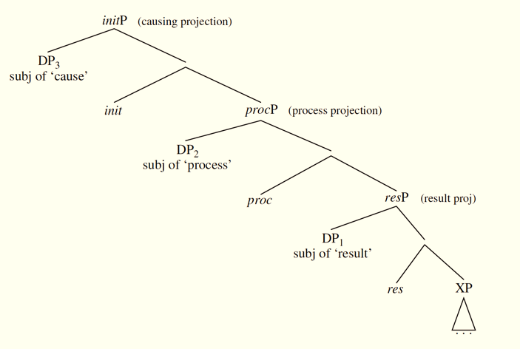
1 | 2 | 3 | 4 | 5 | 6 | 7
Introduction
5
1.4. Proposal
1.4.1. Background on the descriptive properties of SVCs
Sebba (1987), Aikhenvald (2006), and Muysken (2006)
Single event interpretation
Shared inflectional features
Lack of elements of syntactic dependency
1.4.2. Background on the syntactic structure of SVCs
Complementation (Larson, 1991. Taken from Baker 1991)
Event structure (Ramchand, 2008)

Slide 7
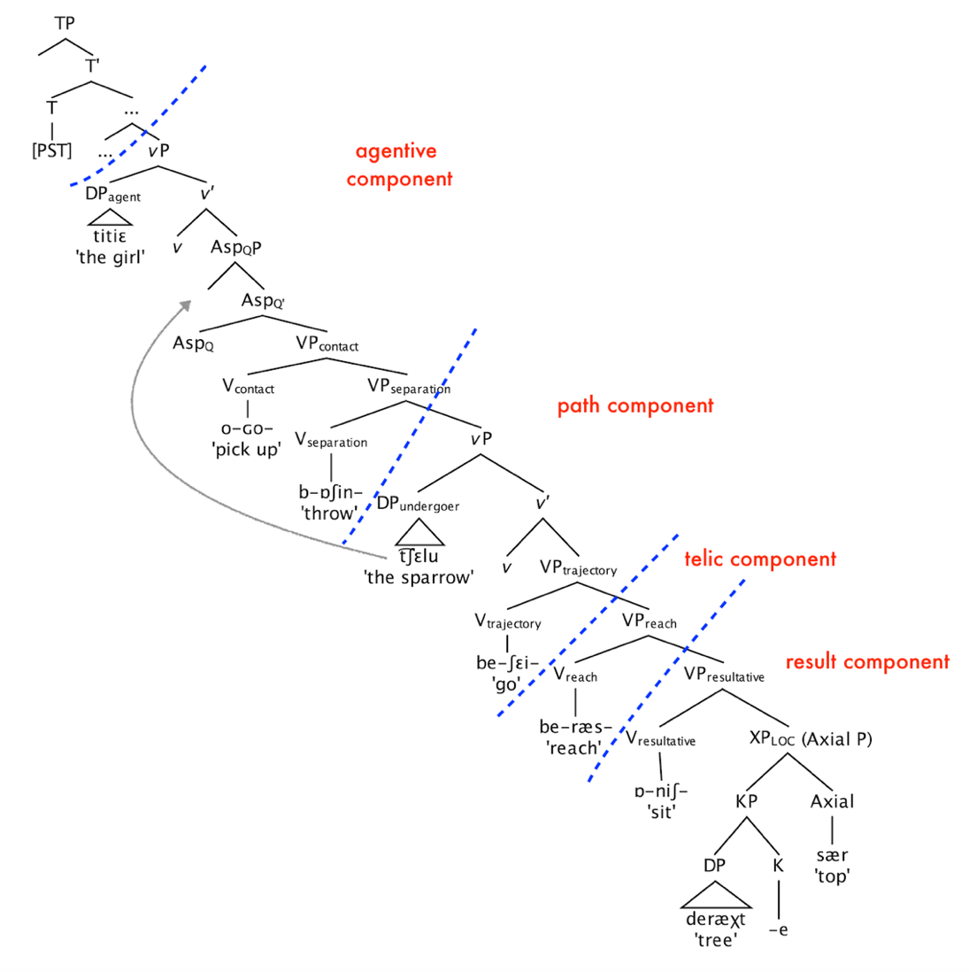
1 | 2 | 3 | 4 | 5 | 6 | 7
Introduction
6
1.4. Proposal
1.4.3. Hypothesis
Highly inflected (complex) morphology
Tati verbal series expressing a MP
H1. Mono-eventive despite all the morphology
H2. Underlying structure based on complementation
H3. sub-eventive components:
Agentive, Telic, and Resultative components merged around Path
Notes:
tense feature is morphologically encoded within the specific stem of the verb

Slide 8
1 | 2 | 3 | 4 | 5 | 6 | 7
2. Evidence for the hypotheses
7
2.1. Mono-eventivity of SVCs
2.1.1. Non-compositionality of meaning
2.1.2. Single Inflectional spine
2.1.3. Single agreement morpheme
2.1.4. Single phonological phrase
2.1.5. Lack of pro
2.2. Complementation structure of SVCs
2.2.1. Bound-variable test
2.2.2. Polarity Item (PI) test
2.2.3. Subjunctive-under-negation test
2.2.4. WH-formation test

Slide 9
1 | 2 | 3 | 4 | 5 | 6 | 7
2. Evidence for the hypotheses
8
2.1. Mono-eventivity of SVCs
2.1.1. Non-compositionality of meaning
SVCs denotations cannot be fully calculated as the sum of the meanings of its components (verbs).
Meaning is calculated as the intersection of meanings
Notes:
It is calculated as the intersection of meaningns

Slide 10
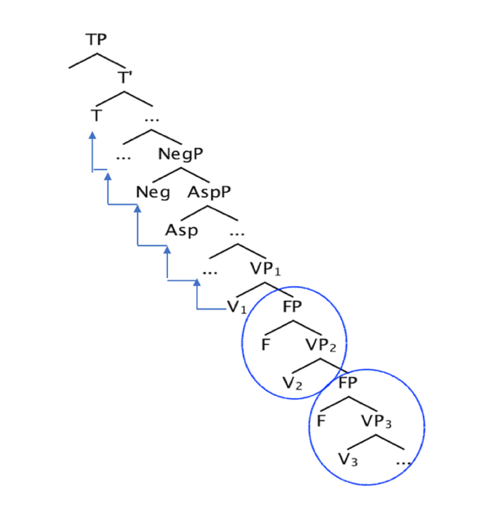
1 | 2 | 3 | 4 | 5 | 6 | 7
2. Evidence for the hypotheses
9
2.1. Mono-eventivity of SVCs
2.1.2. Single inflectional spine
Despite multiplicity of inflectional morphology,
Single inflectional spine, single value for each feature
FPs embedding Vs (Aboh 2009), but lack contentful values
Notes:
shows

Slide 11
1 | 2 | 3 | 4 | 5 | 6 | 7
2. Evidence for the hypotheses
10
2.1. Mono-eventivity of SVCs
2.1.2. Single inflectional spine
2.1.2.1.Single tense value
Lack of independent contrasts in tense marking
Single time constituent
2.1.2.2. Single aspect value
Lack of independent contrasts in aspect marking
2.1.2.3. Single negation value (and marker)
Lack if independent verb negations
Notes:
COntrasts in the Tense marking

Slide 12
1 | 2 | 3 | 4 | 5 | 6 | 7
2. Evidence for the hypotheses
11
2.1. Mono-eventivity of SVCs
2.1.2. Single inflectional spine
2.1.2.1. Single tense value
Lack of independent contrasts in tense marking
Single time constituent
2.1.2.2. Single aspect value
Lack of independent contrasts in aspect marking
2.1.2.3. Single negation value (and marker)
Lack if independent verb negations
Notes:
COntrasts in the Tense marking

Slide 13
1 | 2 | 3 | 4 | 5 | 6 | 7
2. Evidence for the hypotheses
12
2.1. Mono-eventivity of SVCs
2.1.2. Single inflectional spine
2.1.2.1. Single tense value
Lack of independent contrasts in tense marking
Single time constituent
2.1.2.2. Single aspect value
Lack of independent contrasts in aspect marking
2.1.2.3. Single negation value (and marker)
Lack if independent verb negations
Notes:
COntrasts in the Tense marking

Slide 14
1 | 2 | 3 | 4 | 5 | 6 | 7
2. Evidence for the hypotheses
13
2.1. Mono-eventivity of SVCs
2.1.3. Single agreement morpheme
Lack of individual agreement markers
For Past-transitive verbs
2.1.4. Single phonological phrase
Lack of pause/ pitch fall on verbs
2.1.5. Lack of pro
Grammatical result with a non-specific undergoer
Notes:
The issue is that the series of verb , with all that morphology, might lok like clause clause cluse (CP, CP, Cp). I am showing that they are not separate clauses but SVCs. Say these earlier.

Slide 15
1 | 2 | 3 | 4 | 5 | 6 | 7
2. Evidence for the hypotheses
14
2.1. Mono-eventivity of SVCs
2.1.3. Single agreement morpheme
For Past-transitive verbs
2.1.4. Single phonological phrase
Lack of pause/ pitch fall on verbs
2.1.5. Lack of pro
Grammatical result with a non-specific undergoer

Slide 16
1 | 2 | 3 | 4 | 5 | 6 | 7
2. Evidence for the hypotheses
15
2.1. Mono-eventivity of SVCs
2.1.3. Single agreement morpheme
For Past-transitive verbs
2.1.4. Single phonological phrase
Lack of pause/ pitch fall on verbs
2.1.5. Lack of pro
Grammatical result with a
non-specific undergoer

Slide 17
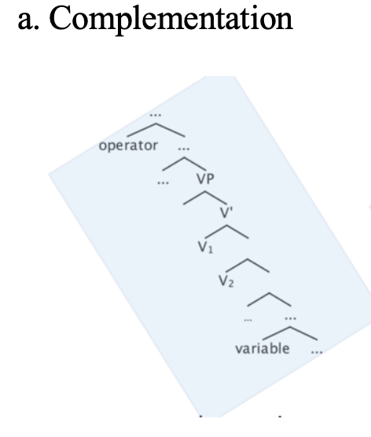
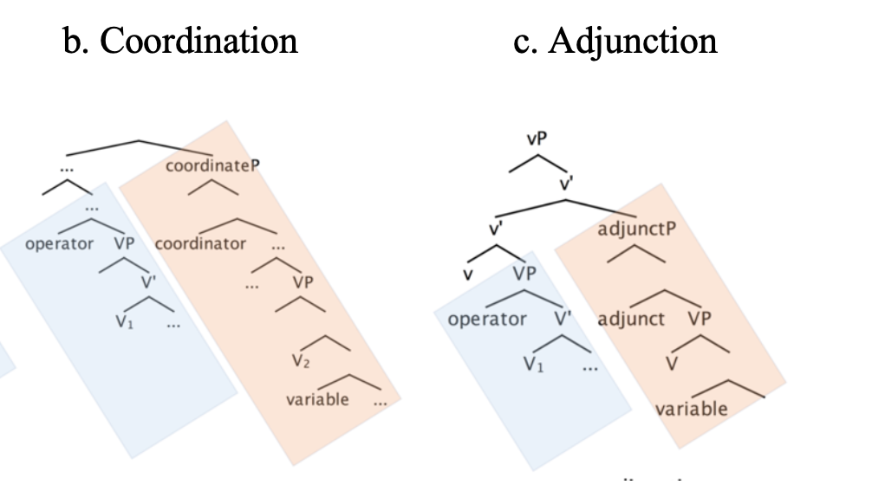
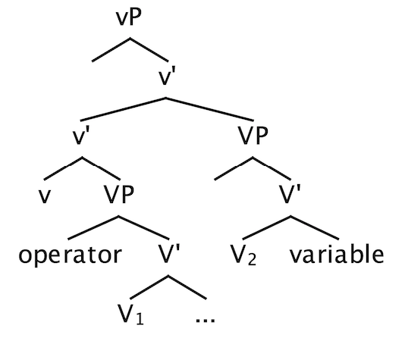
1 | 2 | 3 | 4 | 5 | 6 | 7
2. Evidence for the hypotheses
16
2.2. Complementation structure of SVCs
Prediction: operator-variable binding
Notes:
V2 is in c-command domain of v1. also, putting a bound variable low in the structure, in a complementation stru, this variable is within the c-command domain of the operator but in coordination and adjunction is out of the c-coam domain of operator. Thus, in complementation, it is predicted that the variable will be bound by the operator (binding= c-command and co-indexation. That is why a lot of things are within the c-command domain of each operator but not bound by them because they cannot be co-indexed. Only the operator, if within the c-comm domain, can be bound.

Slide 18
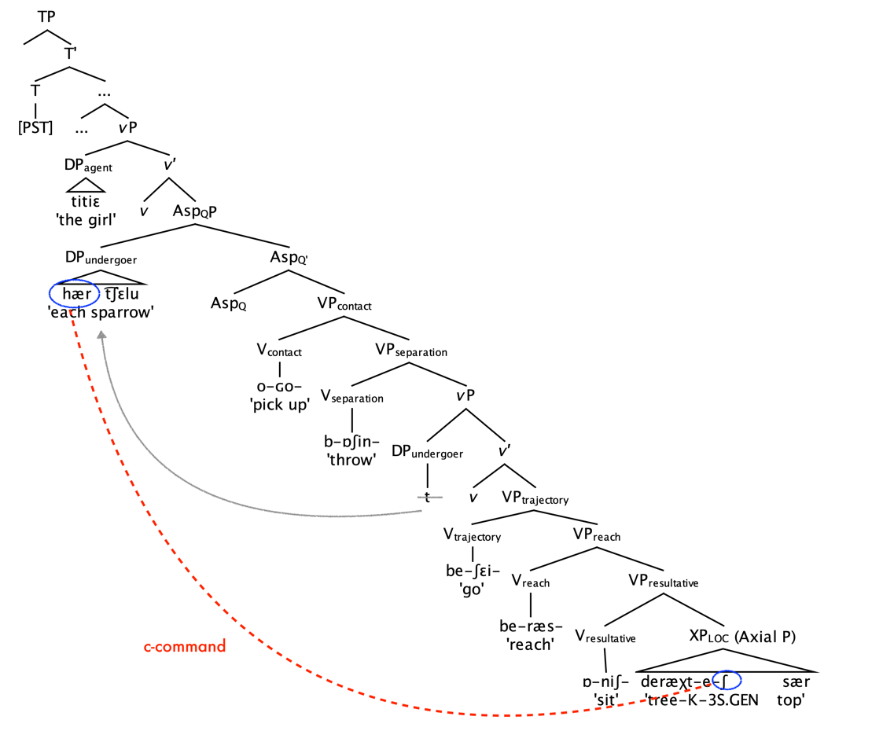
1 | 2 | 3 | 4 | 5 | 6 | 7
2. Evidence for the hypotheses
17
2.2. Complementation structure of SVCs
2.2.1. Bound-variable test
one-to-one correspondence reading
Notes:
If complementation is the structure is the true stu for SVCs, which indeed is, them putting a variable lower in the stru, and an operator higher on the undergoer, since the variable is withing the c-coma doain of the operator, then it is predicted that the operator bind thes variable, which is indeed the case in

Slide 19
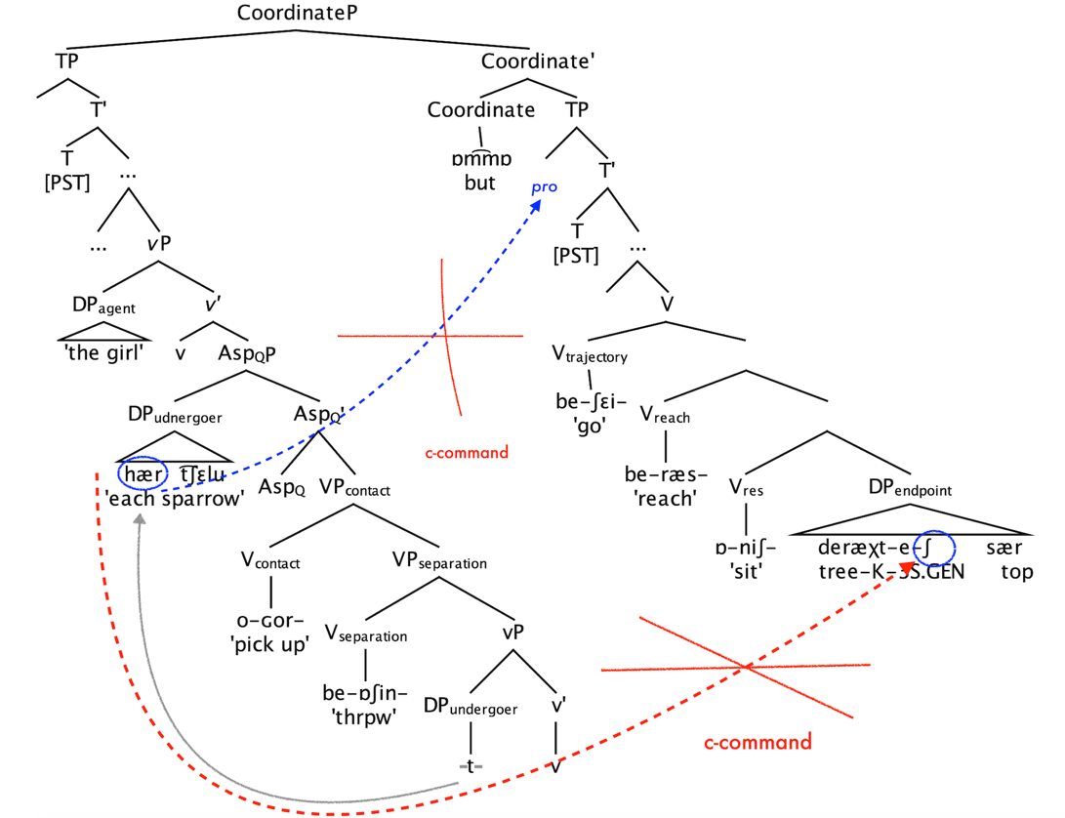
1 | 2 | 3 | 4 | 5 | 6 | 7
2. Evidence for the hypotheses
18
2.2. Complementation structure of SVCs
2.2.1. Bound-variable test (Cont.)
No one-to-one correspondence reading
Notes:
In a structure based on coordinstion, since the variable is out of the c-command domain of the operator. Then the operator cannot bidn the variable. As confirmed through using a overt conjunction.

Slide 20
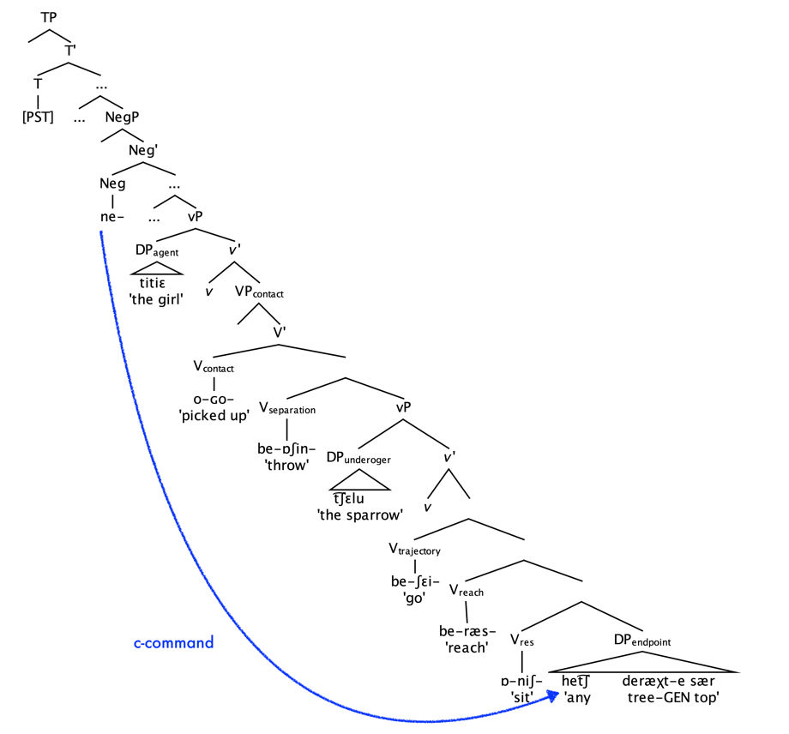
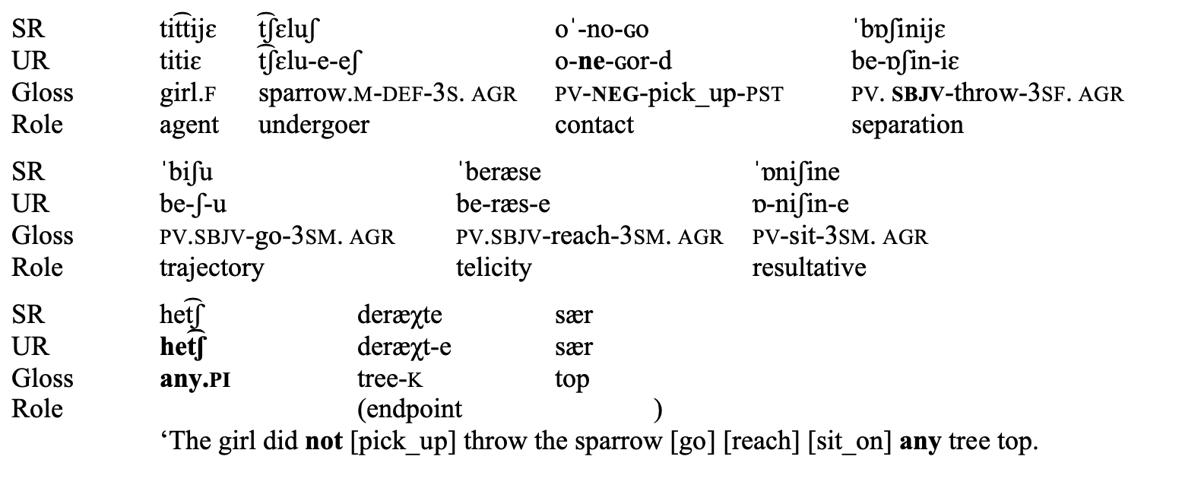
1 | 2 | 3 | 4 | 5 | 6 | 7
2. Evidence for the hypotheses
19
2.2. Complementation structure of SVCs
2.2.2. Polarity-Item (PI) test
one-to-one correspondence reading
Notes:
Polarity item needs to be bound by negation. if complementation is the right stru, then a PI lower in the structure needs to be licensed by negation. Note negation can only be marked on the highest stem otherwise it breaks the mono-eventivitiy . The prediction is true because the PI produces a grammatical result with negation which is marked on the higest verb (if neg is marked on the other verbs it breaks mono-eventive_)

Slide 21
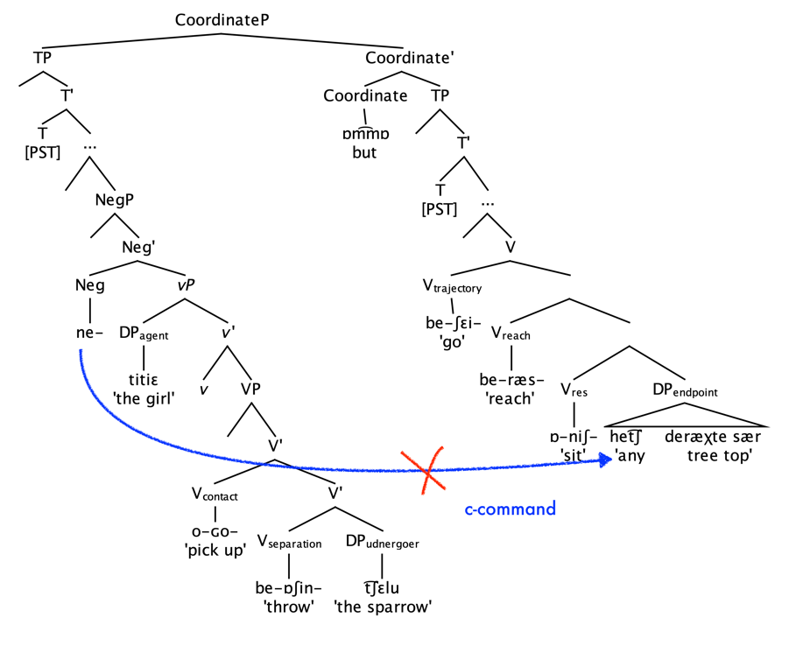
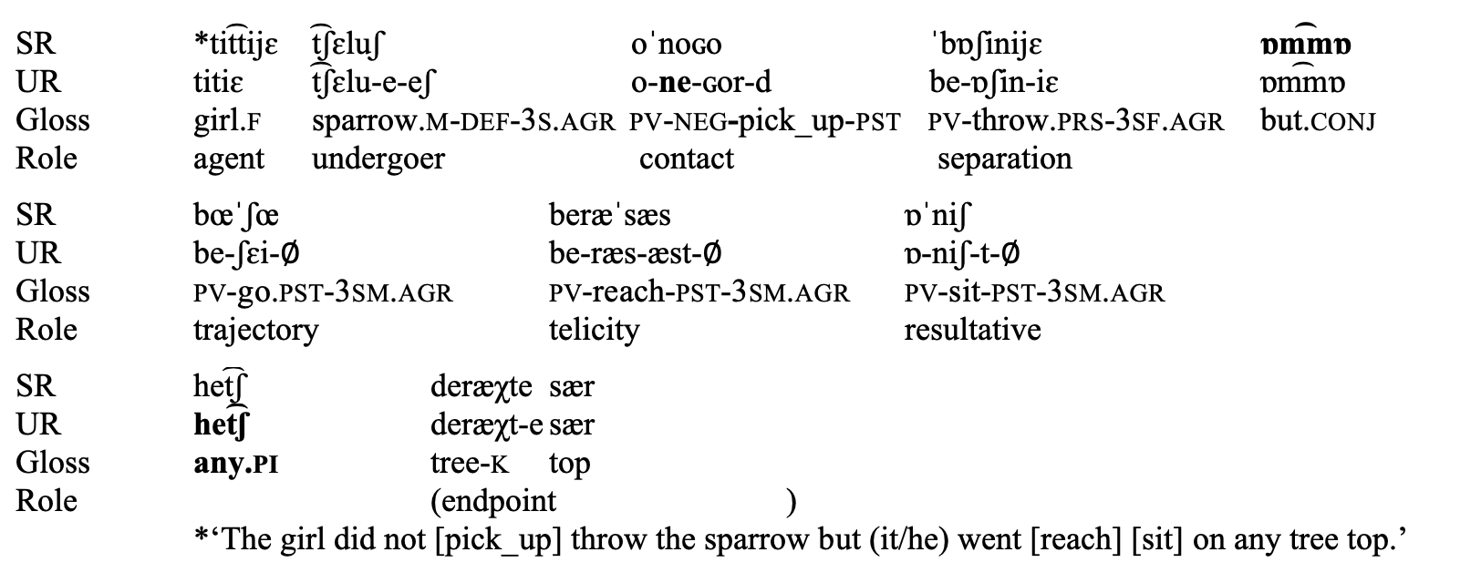
1 | 2 | 3 | 4 | 5 | 6 | 7
2. Evidence for the hypotheses
20
2.2. Complementation structure of SVCs
2.2.2. Polarity-Item (PI) test (Cont.)
Notes:
Instead hech needs to be licienced by a neg within the same caluse with it

Slide 22
1 | 2 | 3 | 4 | 5 | 6 | 7
2. Evidence for the hypotheses
21
2.2. Complementation structure of SVCs
2.2.3. Subjunctive-under-Negation test
Negation is known to have effects on the verb inflections.
Notes:
Croslinguistically, it is well known that ngation can trigger subjunctivity. Spanish

Slide 23
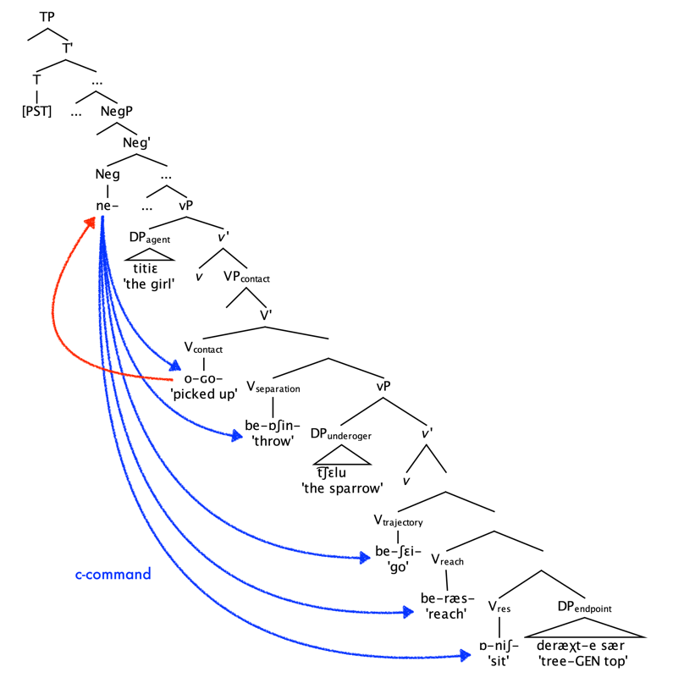
1 | 2 | 3 | 4 | 5 | 6 | 7
2. Evidence for the hypotheses
22
2.2. Complementation structure of SVCs
2.2.3. Subjunctive-under-Negation test

Slide 24
1 | 2 | 3 | 4 | 5 | 6 | 7
2. Evidence for the hypotheses
23
2.2. Complementation structure of SVCs
2.2.3. Subjunctive-under-negation test
Independent CPs with separate MOD value?
Subjunctive is a marker of the scope of negation
a. Inflecting verbs with IND will interrupt the scope of negation
Notes:
but, a morphological byproduct of binding by negation.
The same happens to the Spanish example, in which sbjv disappears in the absence of negation

Slide 25
1 | 2 | 3 | 4 | 5 | 6 | 7
24
b. Subjunctive disappears in the absence of negation: Not a real value
Embedded purpose clauses
SBJV retains
In the absence of negation

Slide 26
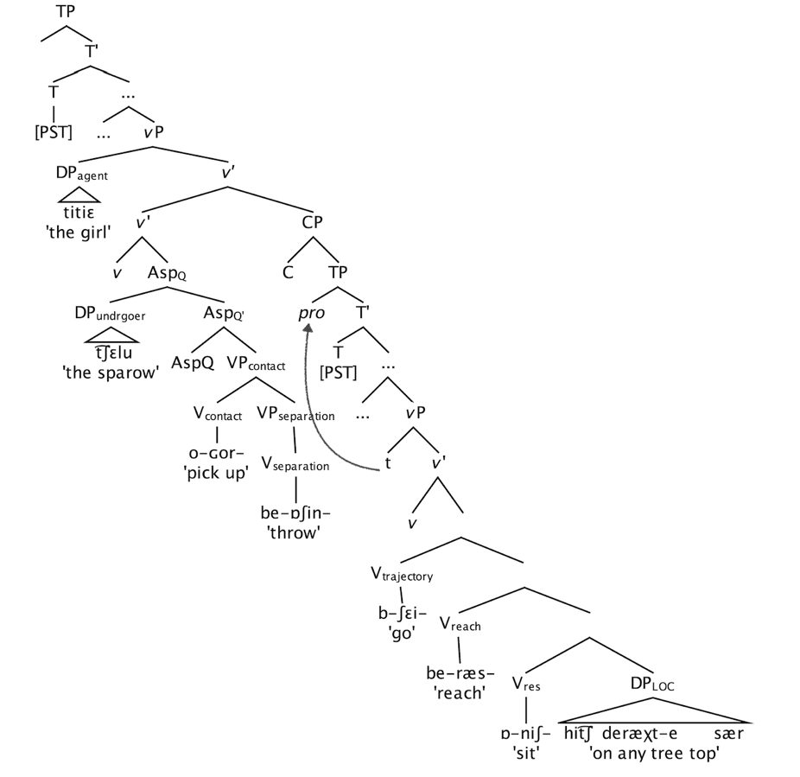
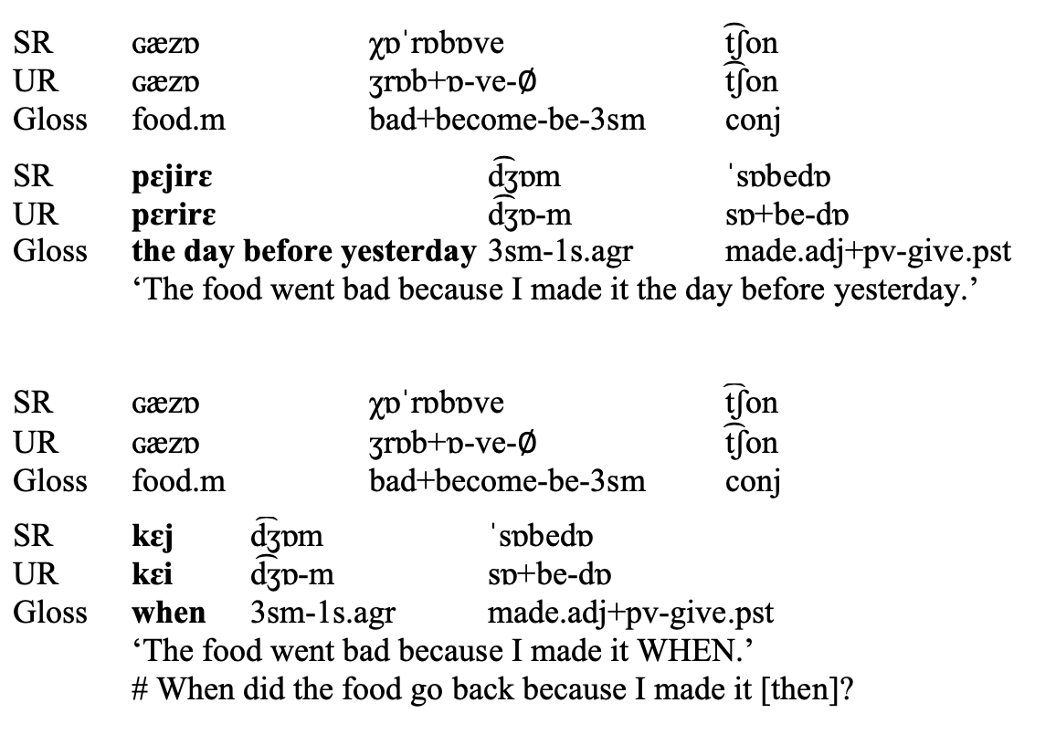
1 | 2 | 3 | 4 | 5 | 6 | 7
2. Evidence for the hypotheses
25
2.2. Complementation structure of SVCs
2.2.4. WH-formation test
a. Extraction out of adjunct clause: echo Q
b. Extraction out of complement clause: info-seeking Q

Slide 27
1 | 2 | 3 | 4 | 5 | 6 | 7
2. Evidence for the hypotheses
26
2.2. Complementation structure of SVCs
2.2.4. WH-extraction test (Cont.)
c. Extraction out of SVCs: info-seeking Q
→ SVCs are made of complementation rather than adjunct structures

Slide 28
SR sælumæt ˈbi
UR sælomæt be-i Gloss healthy PV-be.2S
‘Aloha!’

